Slide 1



ELABORATION: A Comprehensive Benchmark on Human-LLM Competitive Programming
Xinwei Yang, Zhaofeng Liu, Chen Huang, Jiashuai Zhang, Tong Zhang, Yifan Zhang, Wenqiang Lei
Notes:
Hi everyone, today I'm excited to present our work on benchmarking Human-LLM Competitive Programming, which has been accepted to the main conference of ACL 2025.

Slide 2
Background & Motivation
Background:
1. While large language models have attracted attention in competitive programming, their practical utility remains limited due to underwhelming performance.
2. To address this, Human-LLM Competitive Programming employs a human-in-the-loop approach, using multi-turn feedback to improve LLM performance in competitive programming.
Motivation:
Existing research on Human-LLM collaboration in competitive programming is fragmented, lacking a unified understanding, highlighting the need for a comprehensive benchmark to assess its effectiveness across the entire competitive programming process.
Benchmark:
We present ELABORATION, a novel benchmark for Human-LLM competitive programming with a comprehensive evaluation protocol that includes a taxonomy of human feedback and a new human-LLM programming dataset to assess the entire competitive programming process (including comprehension, planning, coding and debugging).
Notes:
First, I’ll start by introducing the background and motivation behind our work.
While large language models have recently gained attention in competitive programming, their actual usefulness remains limited. The reason is simple—current LLMs often struggle to deliver satisfactory performance in this domain.
To address this gap, our project focuses on Human-LLM Competitive Programming, where we take a human-in-the-loop approach. This means using multi-turn feedback from humans to guide and improve the LLM's problem-solving process.
Now, what motivates our work is the fragmented nature of current research in this area. Most existing studies lack a unified framework, making it difficult to compare results or fully understand the role of human-LLM collaboration. That’s why we see a strong need for a comprehensive benchmark.
To fill this gap, we introduce ELABORATION—a novel benchmark designed specifically for Human-LLM collaboration in competitive programming. It comes with a comprehensive evaluation protocol, a taxonomy of human feedback, and a new dataset to cover the entire competitive programming pipeline, from comprehension and planning to coding and debugging.

Slide 3
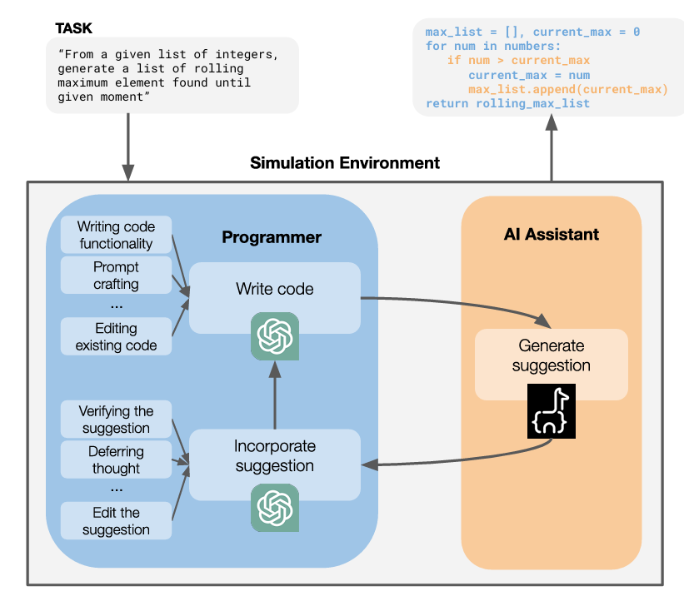
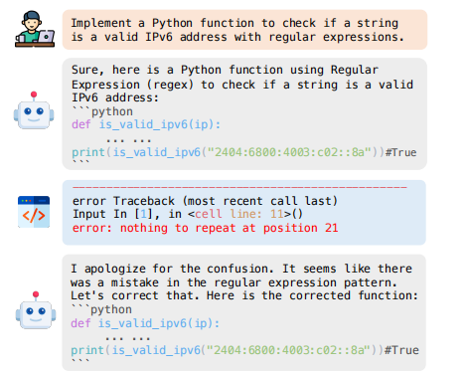
Related Works
Human-LLM Competitive Programming
Current approaches limit human feedback to (pseudo-)code or debugging, overlooking its broader potential, resulting in fragmented insights into human-LLM collaboration.
suggest solution strategies
identifying code errors
Notes:
Now let’s move on to related work in Human-LLM Competitive Programming.
Most current approaches tend to limit human feedback to either writing or correcting (pseudo-)code or debugging errors. While these are important, they only capture a small part of the entire problem-solving process. As a result, our understanding of how humans and LLMs can effectively collaborate remains fragmented.
On the left, you can see a typical simulation setup: the human programmer writes or edits code, while the AI assistant generates suggestions. The human may incorporate these suggestions—but again, this is often restricted to surface-level edits.
On the right, we show a typical interaction, where the LLM writes code with a bug, and the human identifies the error and helps correct it. While helpful, this example shows that most human input is reactive, focusing only on fixing AI mistakes, instead of guiding the overall strategy.
This motivates us to explore broader forms of human feedback—beyond just debugging—and to build a more holistic benchmark that reflects the full range of human-AI collaboration in competitive programming.

Slide 4
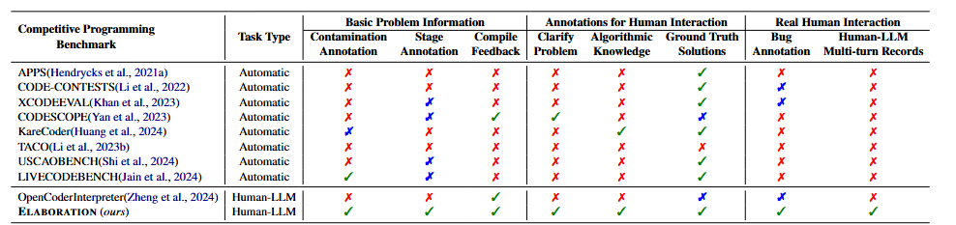
Related Works
Competitive Programming Benchmarks
Difference between ELABORATION and existing competitive programming benchmarks.
Only OpenCoderInterpreter and ours are specifically designed for human-LLM competitive programming;
However, we differ significantly from OpenCoderInterpreter.
Notes:
Next, let’s take a look at how our benchmark, ELABORATION, compares to existing competitive programming benchmarks.
As shown in the table, most prior benchmarks—like APPS, CODE-CONTESTS, and CODEEVAL—are fully automatic and do not support human-in-the-loop collaboration. They mainly focus on evaluating LLMs independently, without considering how humans might interact with the models.
In fact, among all existing benchmarks, only OpenCoderInterpreter and our benchmark are specifically designed for human–LLM competitive programming. But even then, we differ significantly.
While OpenCoderInterpreter provides some support for human interaction, it still lacks several key features—such as contamination and stage annotations, clarification requests, algorithmic knowledge checks, and multi-turn records of real human–LLM collaboration.
In contrast, ELABORATION offers a much more comprehensive view. It includes fine-grained annotations across all stages of the programming process and captures rich multi-turn human–LLM interactions, enabling deeper insights into collaborative coding behaviors.
This makes ELABORATION the most complete benchmark for studying and evaluating human–LLM collaboration in competitive programming to date.

Slide 5
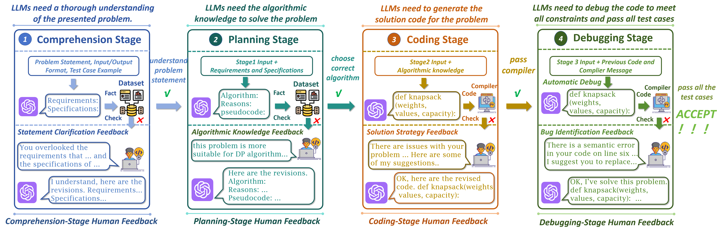
ELABORATION Benchmark
Human-LLM Competitive Programming Evaluation Protocol
Our evaluation protocol accommodates both real human programmers and user simulators to provide feedback at each stage of the competitive programming process.
Notes:
Now I’ll walk you through the core of our benchmark—the Human–LLM Competitive Programming Evaluation Protocol.
Unlike prior work that only focuses on coding or debugging, our protocol covers the full pipeline of competitive programming, broken down into four stages: comprehension, planning, coding, and debugging.
In the Comprehension Stage, the LLM needs to fully understand the problem statement, including inputs, outputs, and constraints. If it misunderstands any part, human feedback is provided to clarify the requirements.
Next is the Planning Stage, where the LLM must identify the correct algorithm to solve the problem. At this stage, we evaluate whether the model can reason about algorithm choices, and again, feedback is provided to correct misconceptions or suggest better strategies.
In the Coding Stage, the LLM generates solution code. Here, humans or simulators give multi-turn feedback to help revise and refine the code—especially when it doesn't compile or fails certain test cases.
Finally, in the Debugging Stage, the LLM must fix semantic or logical errors based on compiler feedback and test case failures. Human feedback helps identify bugs and guide the correction process until all tests are passed.
Together, this multi-stage evaluation protocol allows us to systematically assess and improve LLM performance with human guidance across every phase of competitive programming.

Slide 6
ELABORATION Benchmark
Human Feedback Taxonomy
This taxonomy consolidates the entire programming process into the following primary stages.
Problem Construction
LLMs require a thorough understanding of the problem statement. To facilitate this, human feedback can provide crucial requirements and specifications.
Solution Planning
LLMs engage in solution planning by selecting appropriate algorithms. To facilitate this, human feedback can suggest effective algorithms, provide justifications, and even supply complete and accurate pseudocode.
Code Generation
LLMs must generate complete, compilable code. In this case, human feedback can suggest solution strategies to improve the generated code.
Code Debugging
LLMs must pass the complete set of test cases. In this case, humans assist in identifying errors until all unseen test cases are passed.
Notes:
To support this evaluation, we also define a Human Feedback Taxonomy, which breaks down the entire programming workflow into four primary stages.
The first stage is Problem Construction. Here, the LLM needs to fully understand the problem statement. Human feedback plays a key role in highlighting critical requirements and clarifying any ambiguities.
Next is Solution Planning, where the LLM selects appropriate algorithms. In this stage, human feedback can help by suggesting suitable approaches, explaining reasoning, and even providing pseudocode when needed.
Then comes Code Generation. The LLM must produce working, compilable code. If it fails, humans can offer feedback to guide solution strategies and refine the output.
Finally, in the Code Debugging stage, the LLM needs to fix errors and pass all test cases. Human feedback assists in identifying bugs and ensuring correctness until the solution is fully functional.
This taxonomy not only structures the collaboration process but also helps us evaluate what kinds of feedback matter most, and when they are most effective in guiding LLMs during competitive programming.

Slide 7
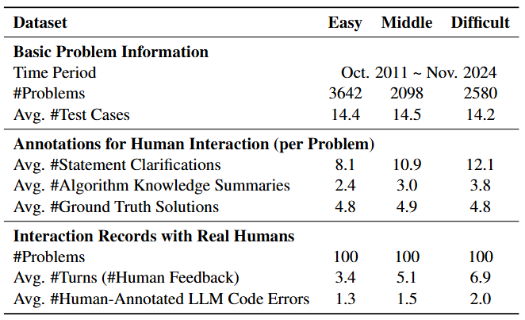
ELABORATIONSET
ELABORATIONSET comprises 8,320 problems from Codeforces and AtCoder between October 2011 and November 2024, meticulously annotated to enable both large-scale simulated human feedback and cost-effective studies using real human participants across all stages of the programming process.
Notes:
Let me now introduce ELABORATIONSET, the dataset that powers our benchmark.
ELABORATIONSET contains 8,320 problems collected from Codeforces and AtCoder between October 2011 and November 2024. Each problem is carefully annotated to support both large-scale simulated human feedback and more cost-effective experiments with real human participants.
As shown in the table, the dataset is balanced across easy, middle, and difficult levels. On average, each problem includes around 14 test cases, regardless of difficulty.
We also provide rich annotations for human interaction. For example, difficult problems tend to have more clarification turns, more detailed algorithm summaries, and slightly more ground truth solutions—showing that problem complexity is aligned with annotation density.
In addition, we include real interaction records: for each difficulty level, we conducted 100 human–LLM collaborative sessions, capturing an average of 3 to nearly 7 turns of feedback per problem, and annotating the model’s code errors along the way.
Altogether, ELABORATIONSET provides a comprehensive and scalable foundation for studying how humans can guide LLMs through the full competitive programming process.

Slide 8
Research Questions
Questions:
Overall Performance (RO1) :
Are LLMs qualified competitive programmers?
How effective can human feedback be in assisting LLMs with competitive programming challenges?
Finer-grained Analysis(RQ2):
At what stage of the programming process is human feedback most beneficial?
What are characteristics of human feedback?
Collaborating with Real Humans(RQ3):
How valuable is human-LLM collaboration from a practical perspective?
How do human and LLM bug detection differ?
How effectively does LLM utilize different types of feedback?
Notes:
To guide our study, we focus on three main sets of research questions.
First, under RQ1: Overall Performance, we ask:
Are LLMs qualified to be competitive programmers?
And how effective is human feedback in helping them succeed?
These questions help us assess the baseline capabilities of LLMs and how much improvement human support can bring in real competitive programming challenges.
Second, in RQ2: Finer-Grained Analysis, we dive deeper into the collaboration process:
At which stage of programming is human feedback most impactful?
And what are the different characteristics of feedback provided by humans?
This allows us to understand not just whether human input helps, but how and when it helps the most.
Finally, RQ3 focuses on real human collaboration:
How useful is Human–LLM collaboration in practice?
Do humans and LLMs detect bugs in similar ways—or do they complement each other?
And how well can LLMs make use of different types of feedback?
By answering these questions, we aim to understand the practical value of human–LLM teaming in real-world coding scenarios.
Together, these research questions drive both our benchmark design and experimental evaluation, helping us better assess the future of LLM-assisted programming.

Slide 9
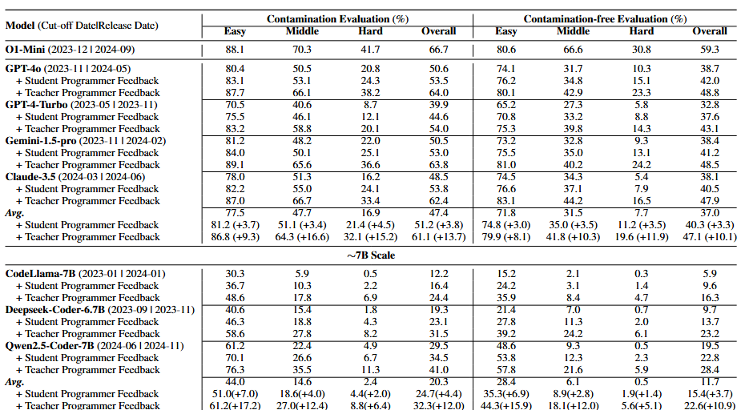
Overall Performance (RQ1)
1. They experimental results demonstrate limited capacity for solving competitive programming problems, particularly those of high difficulty or unseen ones.
2. Human-LLM collaboration significantly enhances LLM performance, demonstrating the crucial role of human feedback.
Notes:
Now let’s look at our results for RQ1: Overall Performance.
First, we observe that current LLMs still have limited capacity for solving competitive programming problems, especially those that are high in difficulty or previously unseen. For example, even strong models like GPT-4 struggle significantly on hard or middle-difficulty problems under the contamination-free setting.
However, once we introduce human feedback, the story changes dramatically.
Across models and scales, Human–LLM collaboration leads to consistent and significant improvements. Whether the feedback is provided by student programmers or more experienced "teacher programmers", we observe performance gains of up to 15 percentage points, especially on middle and hard problems. This demonstrates the crucial role of human guidance in helping LLMs navigate complex tasks.
This trend also holds for smaller models like CodeLlama and Qwen2.5-7B, where the improvements are even more dramatic. Although their baseline performance is much lower, human feedback nearly doubles their scores in some cases—showing that human-in-the-loop systems can partially compensate for model limitations.
In short, while LLMs alone are not yet ready to be competitive programmers, they become far more capable when supported with the right kind of human feedback.

Slide 10
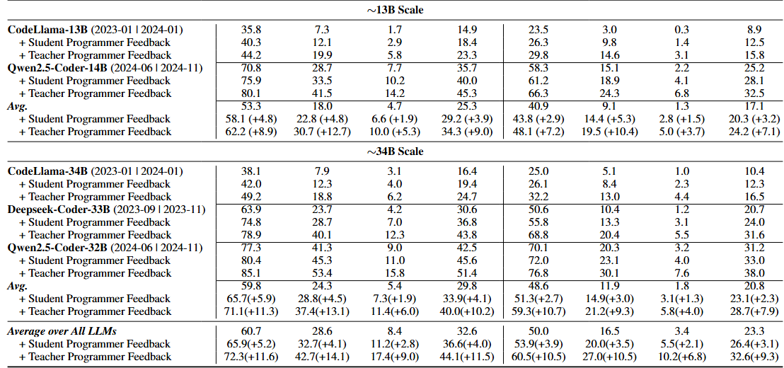
Overall Performance (RQ1)
1. They experimental results demonstrate limited capacity for solving competitive programming problems, particularly those of high difficulty or unseen ones.
2. Human-LLM collaboration significantly enhances LLM performance, demonstrating the crucial role of human feedback.
Notes:
This slide continues our analysis of RQ1: Overall Performance, now focusing on LLMs at larger scales, particularly 13,34B models.
We begin with 13B-scale models, like CodeLlama-13B and Qwen2.5-14B. As shown in the upper table, their baseline performance—without any feedback—is quite limited, especially on hard or unseen problems. However, once we introduce human feedback, we observe consistent improvements across all evaluation dimensions.
With student programmer feedback, performance improves by around +4 to +5 points on average.
With teacher programmer feedback, the gains are even larger—up to +9 or +10 points in many cases, particularly for the Pass@1 metrics.
Moving to 34B-scale models in the lower table, like Deepseek-Coder-33B and Qwen2.5-32B, we see a similar pattern. These larger models start off stronger, but still benefit substantially from human input:
Student feedback boosts their overall performance by ~6 points, while
Teacher feedback results in improvements of 10 to even 13 points, depending on the evaluation type.
Finally, looking at the average over all LLMs at the bottom:
Student feedback improves performance by 11.2%, and
Teacher feedback brings that up to 15.5%, clearly demonstrating the crucial role of both feedback quality and model–human collaboration.In summary, across both 7B and 34B models, human–LLM collaboration consistently boosts performance—especially on the hardest and most realistic test settings—further underscoring the importance of incorporating human-in-the-loop systems for competitive programming tasks.

Slide 11
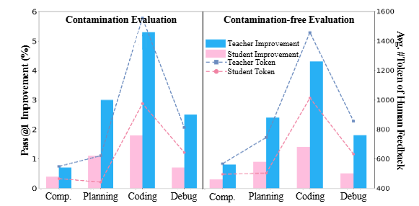
Finer-grained Performance (RQ2)
1. During the coding stage, even on problems with no data contamination, the human feedback is most beneficial.
2. Expert feedback(Teacher Programmer) yields greater benefits, its higher cost necessitates efficient use of human resources.
Student Programmer: (Intermediate Skill Level) possess more than basic programming knowledge but lack the deep expertise.
Teacher Programmer: (Expert Level) possess a high level of programming skill and experience.
Notes:
Next, we address RQ2: Finer-grained Performance—specifically, when and how human feedback is most beneficial.
Our results show that the coding stage is where human feedback has the greatest impact, even when no contamination is present. This suggests that LLMs particularly struggle when translating plans into executable code, and targeted human guidance here is especially valuable.
We also compare feedback from two types of human collaborators:
Student Programmers, who have intermediate-level skills.
Teacher Programmers, who are experts in programming.
As the bar charts show, teacher feedback consistently leads to higher performance gains, especially during coding and planning stages. However, this improvement comes at a cost—teacher feedback typically involves more tokens, indicating a higher annotation and time burden.
This brings us to an important point: while expert feedback provides greater benefits, its efficiency matters. For real-world deployment, we need to strike a balance between feedback quality and resource cost.
In short, to maximize impact, we should focus feedback on the coding stage and consider using expert feedback strategically for the most difficult or critical moments in the programming process.

Slide 12
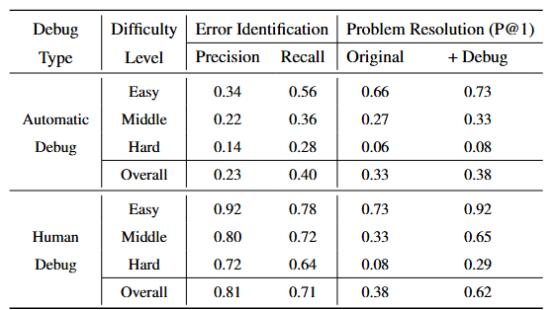
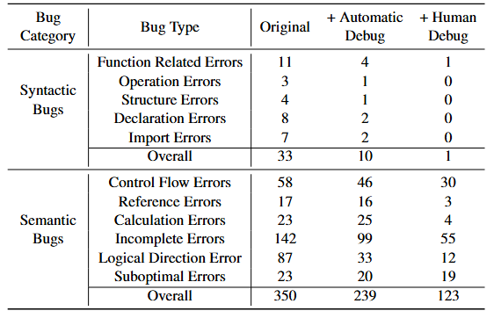
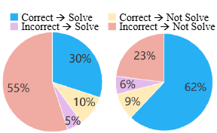
Collaborating with Real Humans (RQ3)
1. Humans play a vital role in identifying bugs and improving LLM performance.
2. Human and LLMs have complementary strengths, creating a powerful synergy.
3. Experiment result demonstrate that higher success rates correcting bugs with accurate human feedback.
Notes:
Finally, let’s look at RQ3: Collaborating with Real Humans.
Our experiments show that humans play a vital role in identifying bugs and improving LLM performance—especially in the debugging phase.
First, looking at the table on the left, we see that automatic debugging methods struggle across all difficulty levels, with low precision and recall. In contrast, human debugging achieves much higher precision (0.81) and recall (0.71), and it significantly improves final problem resolution—raising Pass@1 from 0.38 to 0.62 overall.
Second, if we break down the types of bugs in the table on the right, we find that LLMs and humans have complementary strengths. For instance, LLMs are better at fixing surface-level issues like control flow or calculation errors. Meanwhile, humans excel at detecting more subtle or semantic bugs—like logical direction errors or incomplete reasoning.
The pie charts further support this. On the right, we see that when human feedback correctly identifies the bug, the success rate of fixing it is as high as 62%. In contrast, incorrect or vague feedback results in much lower success.
In summary, accurate human feedback dramatically boosts bug resolution success, and the synergy between LLMs and humans creates a powerful debugging system—far more effective than either could achieve alone.

Slide 13
ELABORATION: A Comprehensive Benchmark on Human-LLM Competitive Programming
Xinwei Yang, Zhaofeng Liu, Chen Huang, Jiashuai Zhang, Tong Zhang, Yifan Zhang, Wenqiang Lei
Notes:
To wrap up, our work shows that while LLMs alone still fall short in competitive programming, human–LLM collaboration offers a promising path forward. By designing a comprehensive benchmark and evaluation framework, we not only highlight where LLMs struggle, but also demonstrate how human feedback—especially when timely and accurate—can make a significant difference.
We hope that ELABORATION will serve as a valuable resource for the community, encouraging further research into interactive, human-centered AI systems.

